Slide 1
Lost in Data, various challenges of the cyber paradigm
Zsolt Csutak
PhD Student
NUPS Doctoral School of Military Sciences

Slide 2
What is the ’cyber-world’ about ?
The happy (quasi dystopic) virtual paradigm we live in :
computing devices of the electromagnetic spectrum: e.g PCs, smartphones, smart houses, self-driving cars and even UAVs
DATA overflow (Pew Research: daily internet data traffic around 10 Yotabyte (10 x the volumes of the US Library of Congress in D.C.)
Importance of communication:
lack of Silence and Contemplation
less personal more digital chat:
DEEP VS. SHORT. SUPERFICIAL COMMUNICATION
140 text messages/day/American teenagers

Slide 3
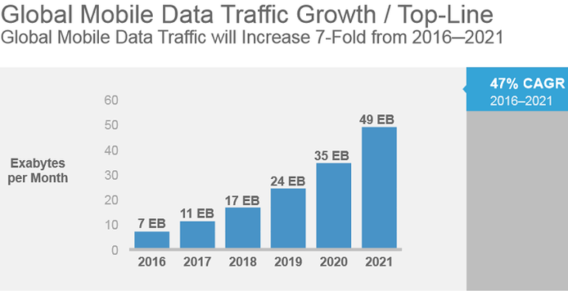
Data over-SPILL ?
How is DATA generated ?
Users : 4.5 bn as of 2017 (Pew Research, STATISTA)
Smart Devices of IoT: 17 bn in 2017
AI, Machine learning, smart algorithms, super computers e.g.
IBM Watson, Great and Deep Blue etc.

Slide 4
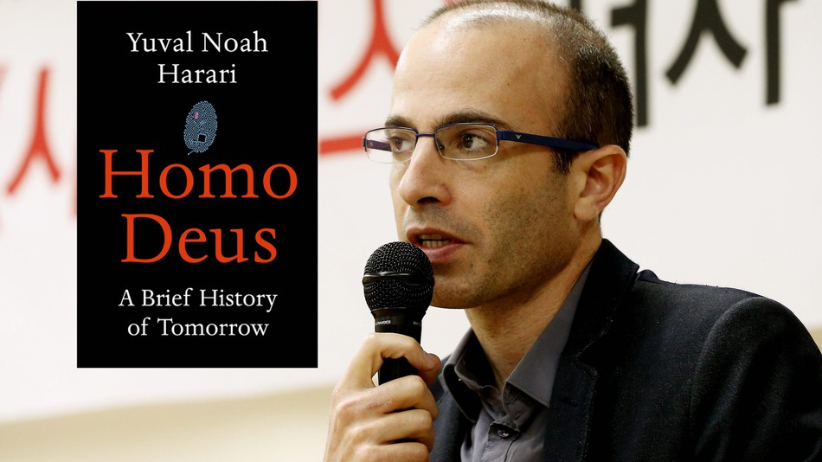
Basic ISSUES to be considered:
Cui prodest ?
Hijacking of information for POWER – SETTING THE AGENDA
‚Weaponization of Information’ (Waltzman ©, RAND Corp.)
Cognitve insecurity: believe nothing, alternative facts and truth, fake news reality
Any kind of Information is part of Soft Power
Digital Secular theoreme:
DATA is the new Religion and INFORMATION is becoming Divine ( Yuval N. Harari)
„Thinking before Believing …”

Slide 5
Who can be in charge of the control/supervision/ data management of the cyber system?
States (e.g.: U.S. NSA, Great Digital Firewall and Social ranking credit system of China)
Non-state actors like :
Web 3 Corp.: Google, Fb, Tw, Amazon
Organizations: ICANN, ITU, WTO
Smart algorithms and the rise of Artificial Intelligence which are operated also by those from above
OR ultimately NOONE – the most complex system ever created

Slide 6
The INFORMATION PARADIGM
PROS:
AVAILABLE
INSTANT
MOSTLY FREE
UNRESTRICTED
CONVENIENT
GROWING DIG.LITERACY
UNPRECEDENTED KNOW-HOW SHARE IN HISTORY

Slide 7
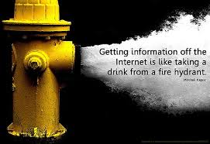
The INFORMATION PARADIGM
CONS:
DATA OVERFLOW
(see the idea of Asimov, Kurtzweil or Moore)
UNCONTROLLED
INSECURE, MANIPULATED
UNRELIABLE
PROMOTES SPIRITUAL INERTIA
ANXIETY, FEELING OF TOTAL LOSS
SUPERFICIAL
COGNITIVE DISORDER
A.I. TAKES OVER CONTROL OF DATA MAN.

Slide 8
WAY OUT FROM THE data CHAOS ALTERNATIVE SOLUTIONS
TO RESTRICT THE UNCONTROLLED DATA GENERATORS: WHO? HOW? ON WHAT BASIS?
GLOBAL DATA FILTER, DIGITAL EDITING
E.G. WIKIPEDIA EDITORS’ COMMUNITY
IMPORTANCE OF EDUCATION, CRITICAL THINKING
THE RISE OF AI: DATA CONTROL ALGORITHMS

Slide 9
References:
HARARI, Yuval: HOMO DEUS, a brief history of Tomorrow, NY, HarperCollins, 2017
KAPLAN, Jerry: Artificial Intelligence, NY, OUP, 2016
KURTZWEIL, Ray: Singularity is Near, NY, Viking, 2005
NIC- National Intelligence Council: Global Trends: Paradox of Progress, Washington D.C., January, 2017
WALTZMAN, Rand: The Weaponization of Information, RAND Corp., Washington D.C., 2017

Slide 10
Thank you for your kind attention !

